Slide 1

How to make YOUR OWN life trackers/diaries
For LIFE MANAGEMENT
BY sinéad boyce

Slide 2
Design Your Day Your Way-for Life Management
Pen & paper & IT
Notebooks
Organising
Tools
Charts and Graphs
Online Creations
Artistic Creations
Its all about Life-Style
How to Customise your own life diaries and trackers?
How to add more functionality to your paper diaries?
In this class I will show you how to create ‘date and topic’ related tables and charts
that map your progress, patterns, trends that you can adapt to your own life-style!

Slide 3
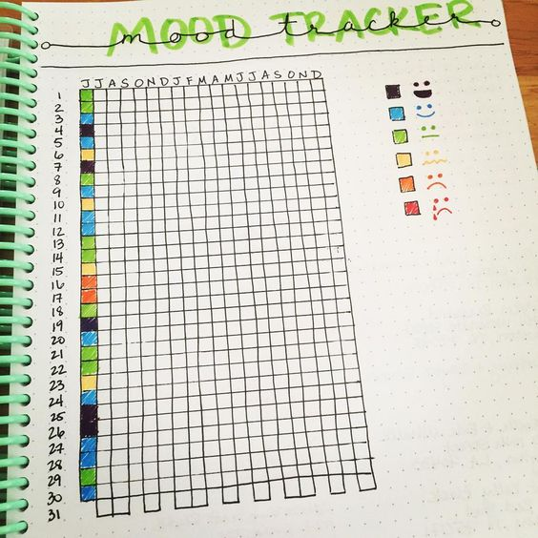
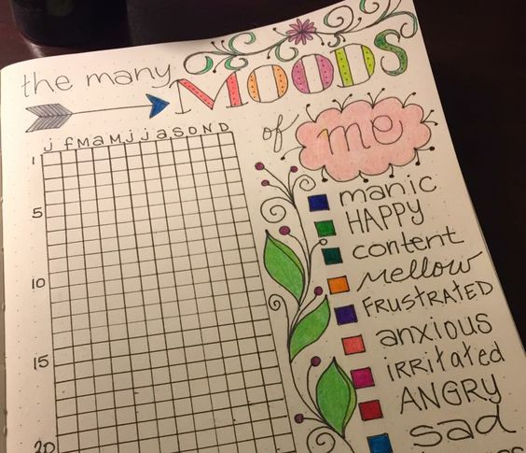

JOURNALS AND DIARY TRACKERS
Here are some examples of hand-drawn ‘Mood-Trackers.’
By the completion of this class, you will be able to create your own trackers.
These will be in Microsoft Excel, which brings to life data entry.
With this tool, at a click of a button, you will see trends and patterns over time.
Then you can sketch out your own tracker topic ideas whether it be mood, spending, diet and more.
And use these sketches as templates for and in addition to your Excel tables and charts.

Slide 4
After this class What you will be able to do…
YOU CAN DO IT!
Tables
Charts
Microsoft Excel
Your data
Automatic update
Time
Trends
This class shows you how to make your own charts and tables using Microsoft Excel as an operational tool.
Microsoft Excel can be downloaded on its own or as part of a Microsoft Office Package and is a standard tool in most computers.
The beauty of this method I will demonstrate is that, once you have created and saved these tables, you then simply enter your information and the associated chart updates automatically.
You will be able to see trends in your activity of choice over: hours, days, weeks, months, years.
So, lets get started->

Slide 5
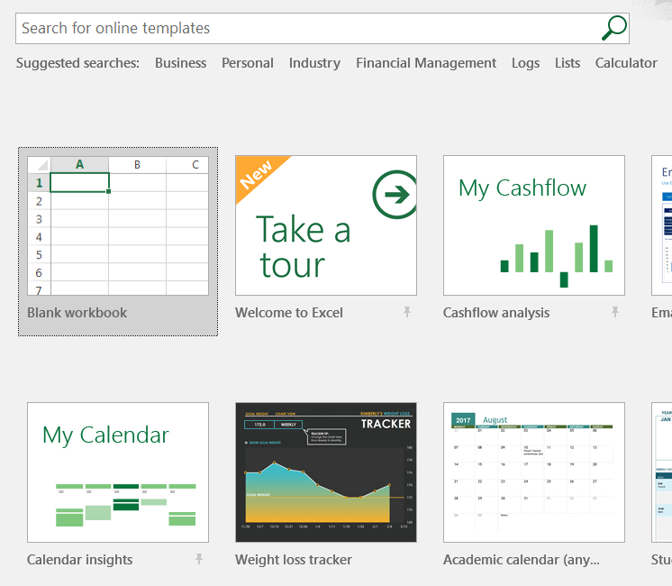
Step 1:
Open Microsoft Excel on your computer.
You will see a selection of templates to choose from.
Select the ‘Blank Workbook,’ by double-clicking with your mouse on that image.
Yellow circles represent points of focus in this class.

Slide 6
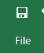
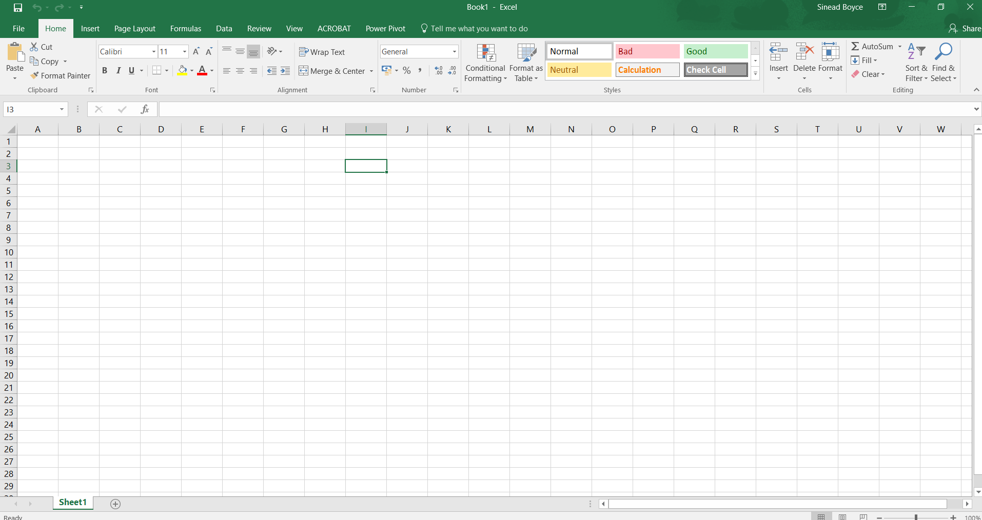
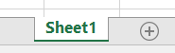
STEP 2:
This is your screen called a ‘spreadsheet’ page in Microsoft Excel.
To save this page-click the save icon at the top left corner of the screen, or use the ‘file-save as’ method.
You can name your spreadsheet. This called ‘sheet 1’ at the base left of screen.
Just double click on this tab to change to a name of your choice.

Slide 7
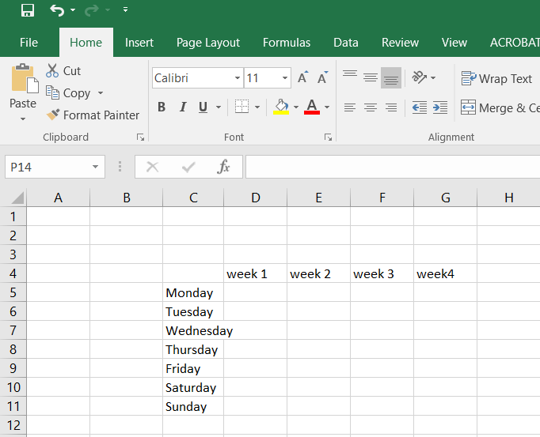
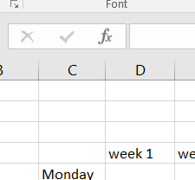
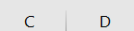
STEP 3:
Entering Data:
Click using your mouse on any square (called a cell), and enter the data as shown on screen.
Notice the text ‘Wednesday’ extends outside the outline box.
To fix this:
Go to the line between ‘C’ & ‘D’ and double click with your mouse. It extends the cell to fit the text.

Slide 8
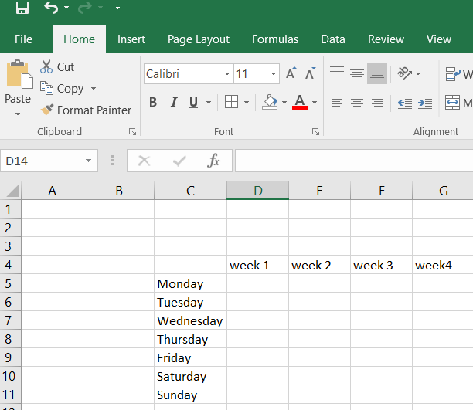
STEP 4:
Your screen now looks like this

Slide 9
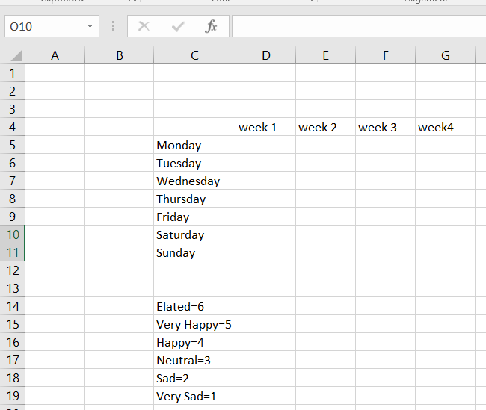
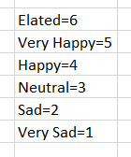
STEP 5:
Next, you type in your descriptive legend.
These are your keys for data entry.
Elated = 1
Very Happy = 2
Happy = 3
Neutral = 4
Sad = 5
Very Sad = 6

Slide 10
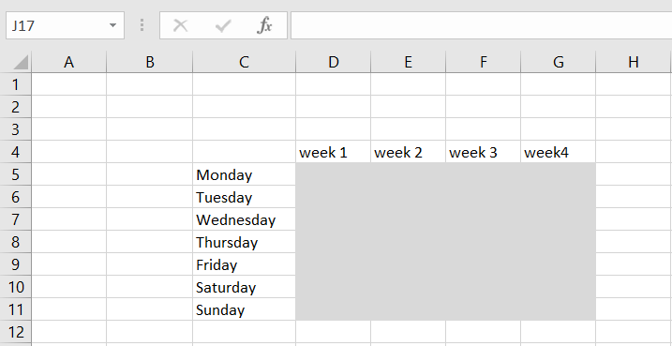
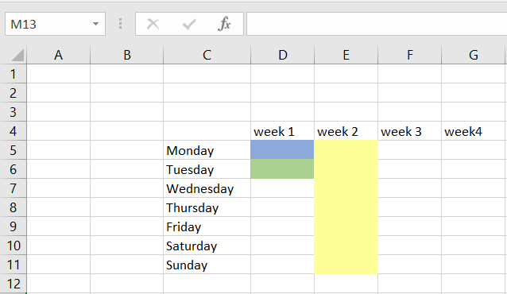
STEP 6:
I have highlighted in grey the area where you enter your data.
This is where you use your legend as on previous slide:
Elated = 6
Very Happy = 5
Happy = 4
Neutral = 3
Sad = 2
Very Sad = 1
For, ‘Elated’ you type 6, if ‘Very Happy,’ you type 5, and so on.
Your first entry on this table is highlighted in blue.
This is where you enter the number corresponding to your mood.
This refers to week 1, Monday.
Your next entry will be the green box, referring to week 1, Tuesday and you continue for each day of the week.
For week 2, you do the same as week 1. The yellow box represents a full week of entries, and you can continue adding entries in this way this for the rest of the month.

Slide 11
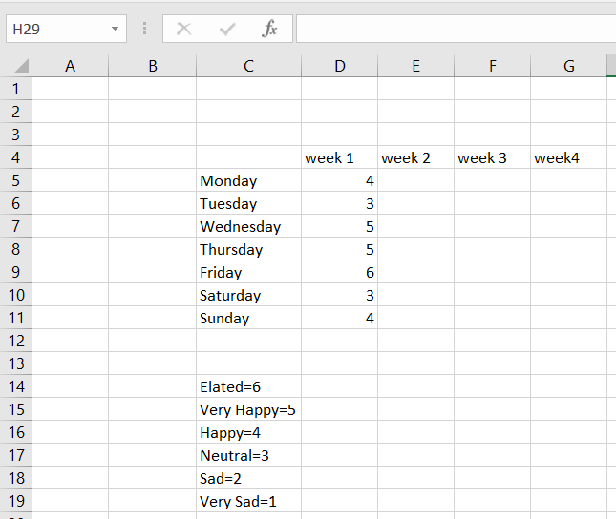
Step 7:
This is how entries for mood for week 1 looks like.
This is an example, you can enter the mood number that corresponds to yourself.

Slide 12
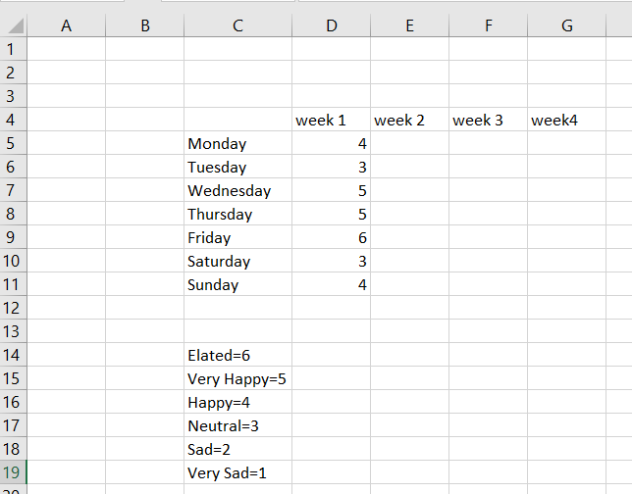
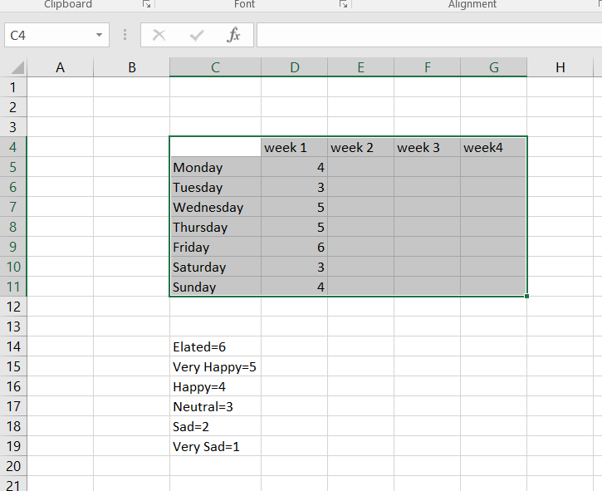
Step 8:
Using the mouse, ‘highlight’ the area of the data table as shown in grey in this image.
The first two images are of the same process.
I added the second one so you can see clearly the area to highlight.
The result is the third image.
To ‘highlight’:
Click with the mouse on the cell (square) where the yellow circle is->
Then drag with the mouse from this cell diagonally to the last cell of the table, where the red circle is located.
This screen area turns from white to grey.

Slide 13
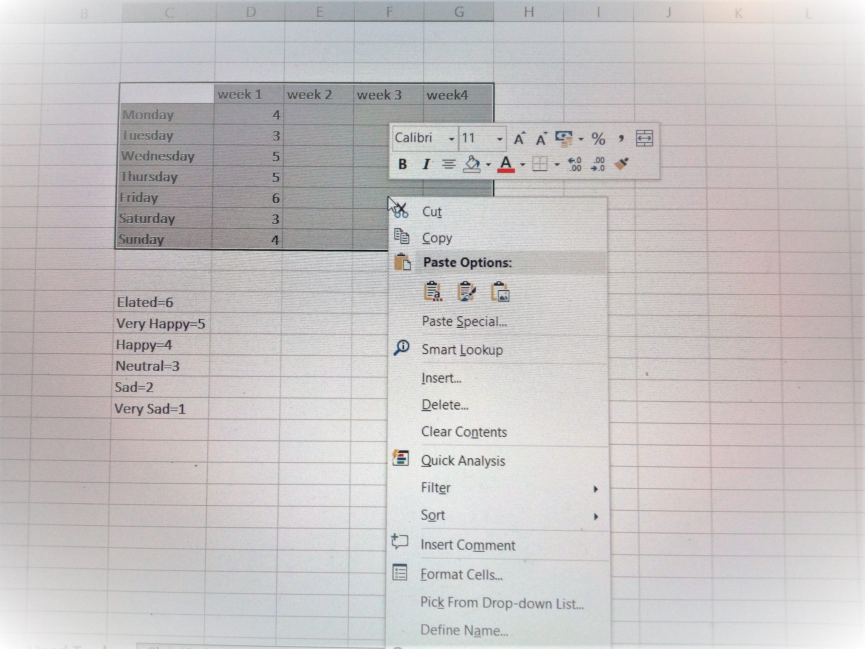
STEP 9:
Right click with your mouse on the highlighted (grey) area.
A drop-down menu appears.
Click on ‘Quick Analysis’ to select this option.

Slide 14
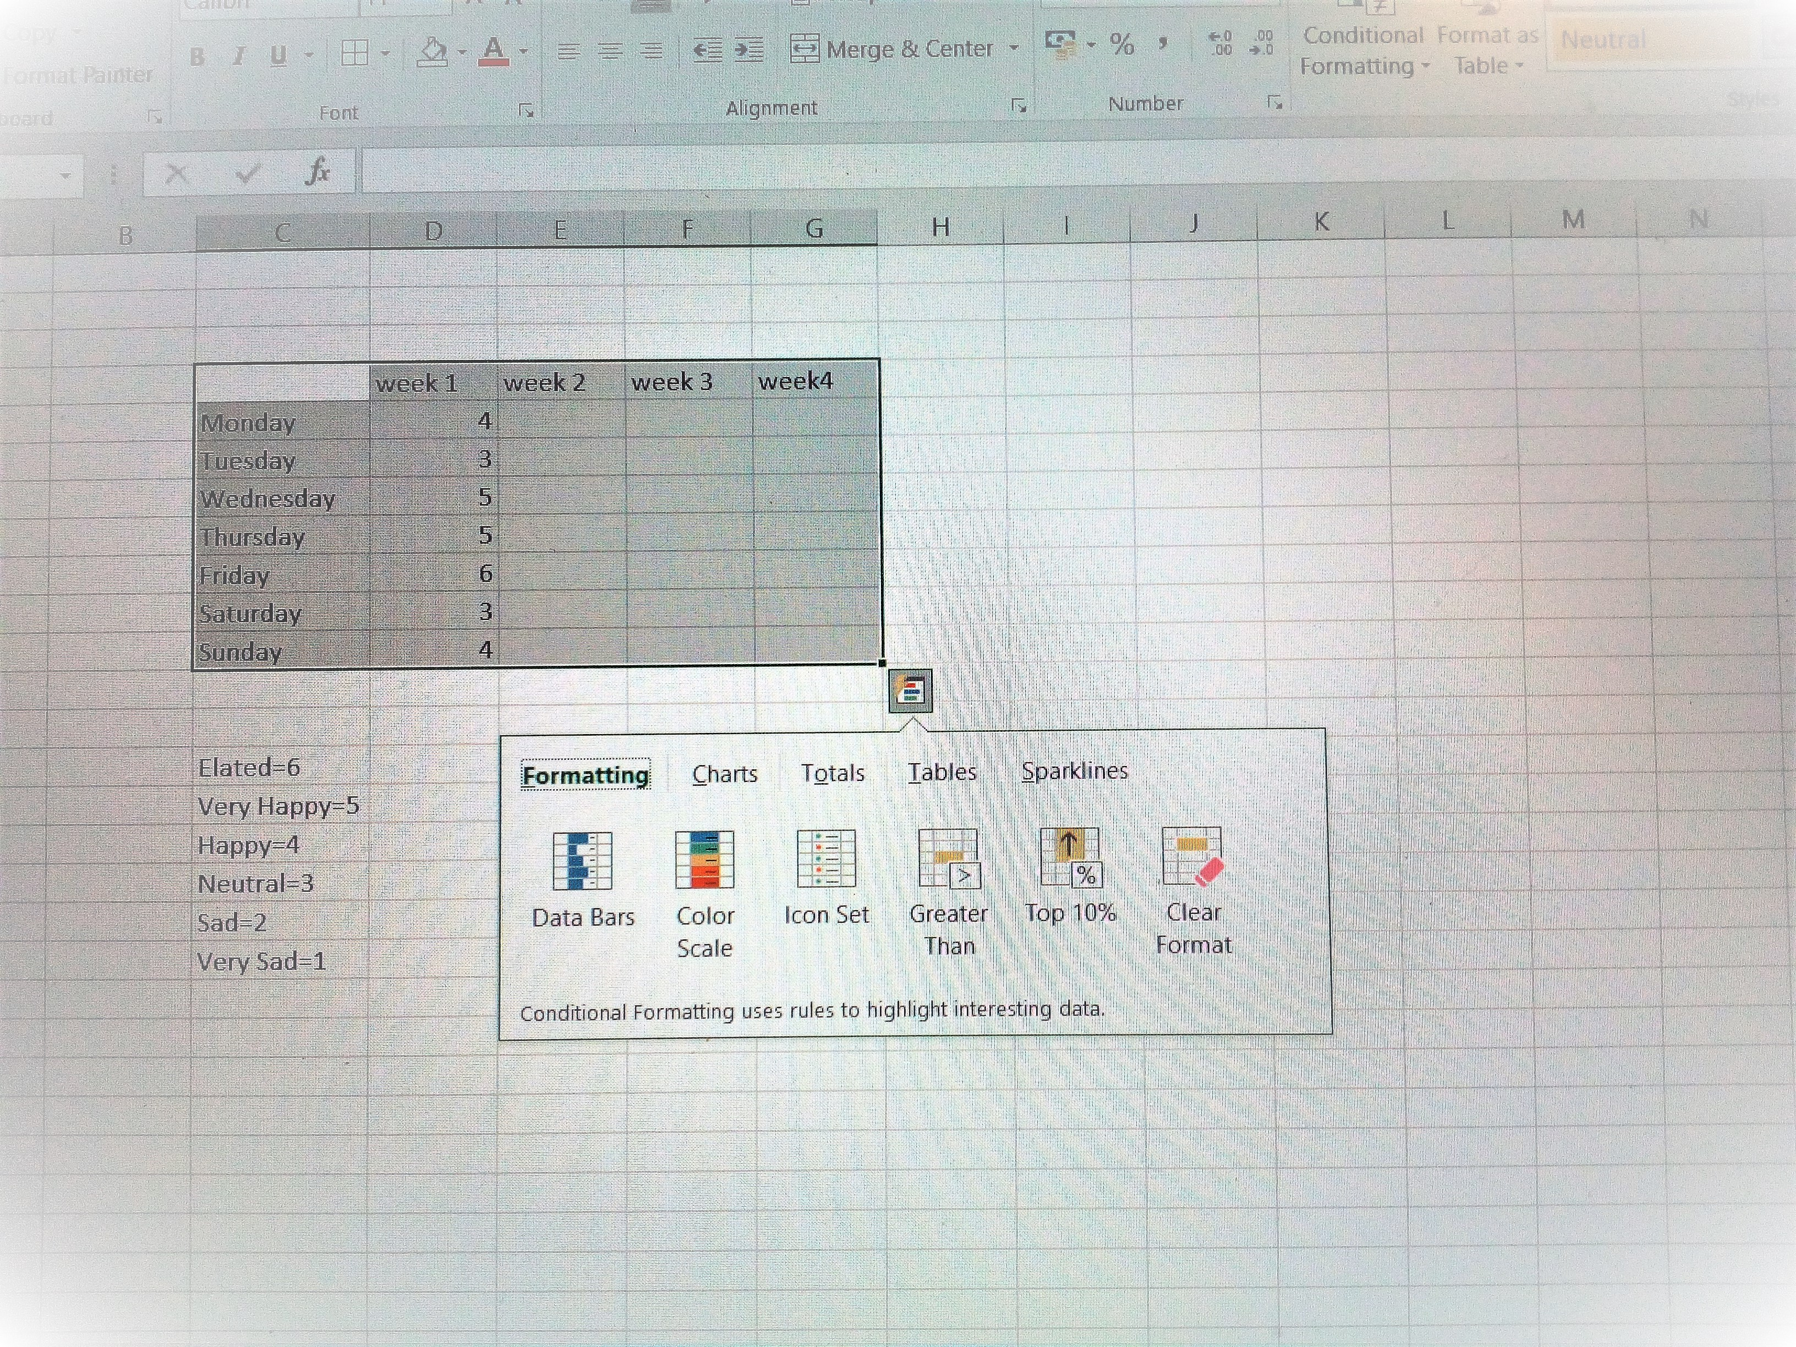
STEP 10:
Following from Step 9-> After selecting ‘Quick Analysis’->
Another box of choices appears.
Here the ‘Formatting’ tab is highlighted.
Clicking on any of these options will produce a different effect.
Try them out to see which you prefer.
Note: If you try one and this options box disappears, simply follow the same steps of: Step 8 & Step 9, to return to this point.

Slide 15
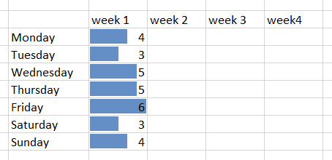
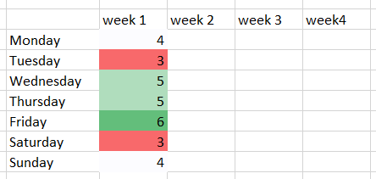
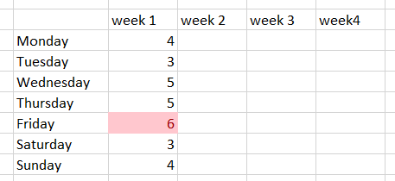
STEP 11:
The ‘Quick Analysis’ using the ‘Data bars’ produces this result.
It is one of the better ways of viewing your data, being clear, concise and you can see at a glance the patterns/trends of your data in this case the data is about ‘Mood.’
However, you can apply this method in the same way to any other life tracker.
This colour scale ‘Quick Analysis’ output shows a range of colours from red-green.
I would think the data bars are clearer to read at this point of week 1.
However, this colour scale is excellent for looking at trends over weeks and months.
This is the ‘Quick Analysis’ result of the ‘Top 10%,’ of your best days.

Slide 16

And now hey presto! YOU HAVE CREATED A LIFE MANAGEMENT ‘MOOD TRACKER’

Slide 17

THANK YOU & HAPPY TRACKING!

